Slide 1
Community Health Assessment

Slide 2
Why a CHA?
Strategically align community needs with resources.
Focuses resources on achieving national prevention goals
Collaborative process required to attain PHAB accreditation.
ACA requires all non-profit hospitals to conduct a community health needs assessment and address community health needs. Public health has experience.
Collaboration is logical; shares costs. Collaboration leads to credibility and community ownership of the responsibility to address health needs.
Notes:
NACCHO data tells us that 75% of local health departments have conducted a community health assessment within the past 5 years. Almost have within last 3 years.

Slide 3
Characteristics of a CHA?
Evidence based
Collaborative
  Seek input from community representatives
  Health care
  Public health
Identify and prioritize community health needs.
Develop strategies to address needs
Share implementation strategy with public

Slide 4
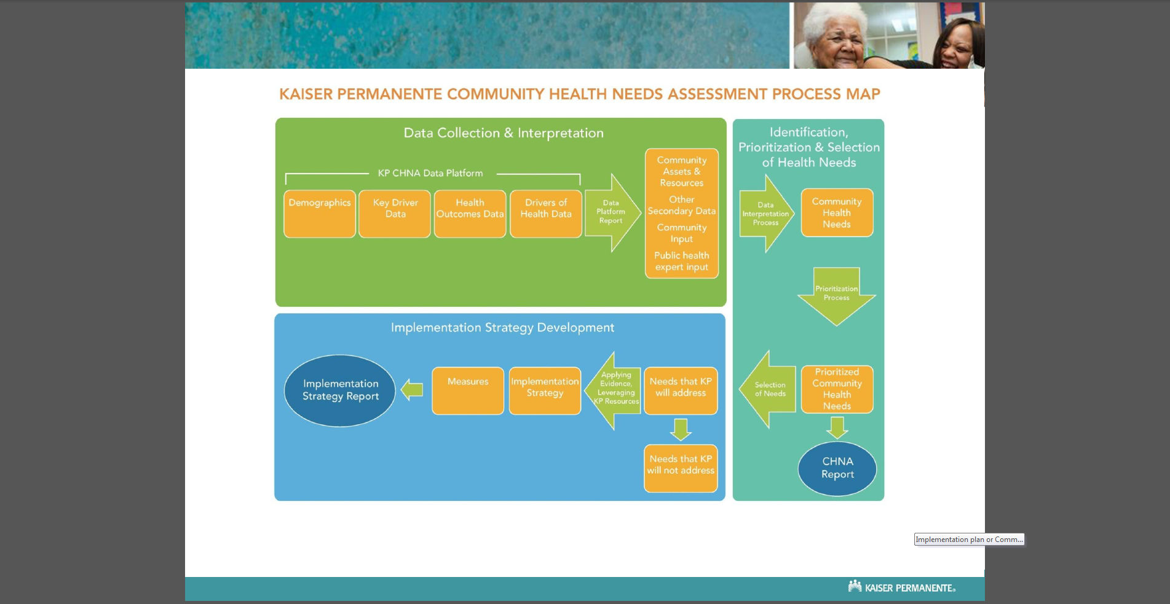

Slide 5
Define the community
  Legally defined entity: city, county state
  Target population (women, children), do not define in such a way that it excludes populations served
  Community served by hospital

Slide 6
Describe the community
Demographics
  Population size, age structure, race/ethnicity, fertility rate
  Key drivers
    education level
    poverty
    unemployment
Physical environment
  Built environment: sidewalks, parks
  Businesses: factories, grocery stores, liquor stores
  Air, water quality
Health behaviors
  Tobacco, alcohol, drug use
  Diet and exercise
  Teen sexual activity
  Injury and violence
  Disparities will be revealed
Notes:
Disparities?

Slide 7
Identify community health assets
Laws, rules, policies
Public health
  School clinics and educators
  Vaccination clinics
  Prenatal education
Healthcare
  % of population with a primary care physician
  ED visits for chronic disease crisis, care, maintenance
  Ambulance service
  % of women < 24 years screened for chlamydia
  % of diabetics with HgA1c in past 6 months

Slide 8
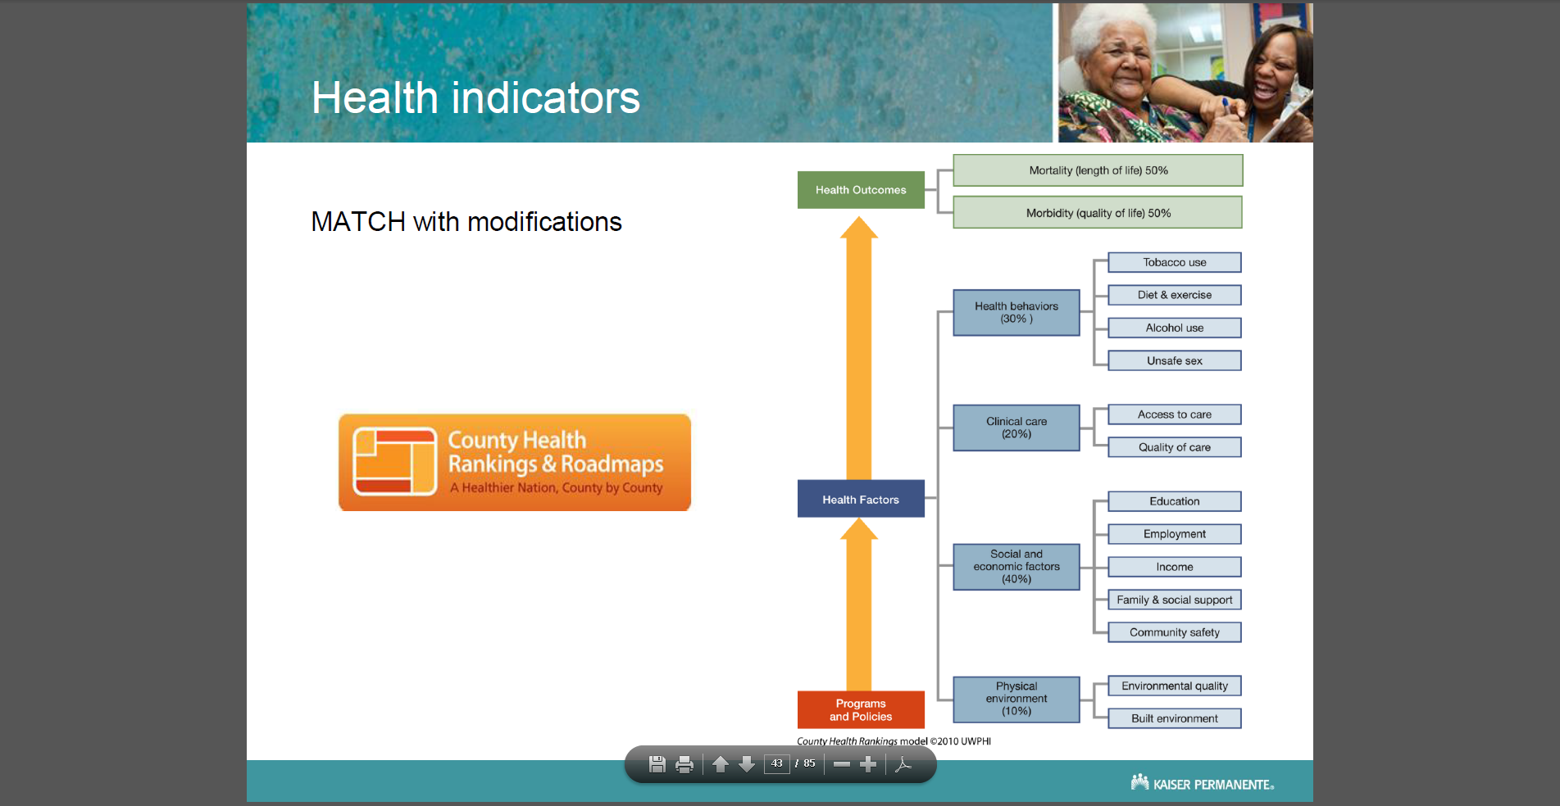

Slide 9
Health Outcomes
Health needs
  Hospital discharge data
  % adults obese
  % children obese, Type 2 diabetes
  Morbidity
  Mortality
    Cardiovascular
    Infant
  Compare to like communities or national data

Slide 10
Health Outcome:
Example Childhood Diabetes
Child mortality rate: 200 per 100,000
  US 64.7 per 100,000
Children with diabetes: 400 per 100,000
  US 250 per 100,000
Find and analyze sources of data
  Hospital discharge data
  % children obese
  Epidemics of viral illnesses
Compare to like communities

Slide 11
Identify and Prioritize Needs
  Transparent process
  Seek community representatives in developing
  Broad comment opportunities
  Identify those that will be addressed and those that will not be addressed

Slide 12
Implementation plan or Community Health Assessment Report
Implementation strategies evidence-based/best practices
Prioritized needs and strategies and process of how those were determined
Role of collaborative partners
Budget
Share progress: Interim and final outcome measures
Re-assessment plan

Slide 13
Review
The CHA process describes health status, assets and barriers in a community.
The CHA both identifies priority health issues in the community that guides budgeting and resource allocation.
The CHA can coalesces community-wide support and commitment to address priorities.
Community involvement is key to developing a viable CHA.

Slide 14
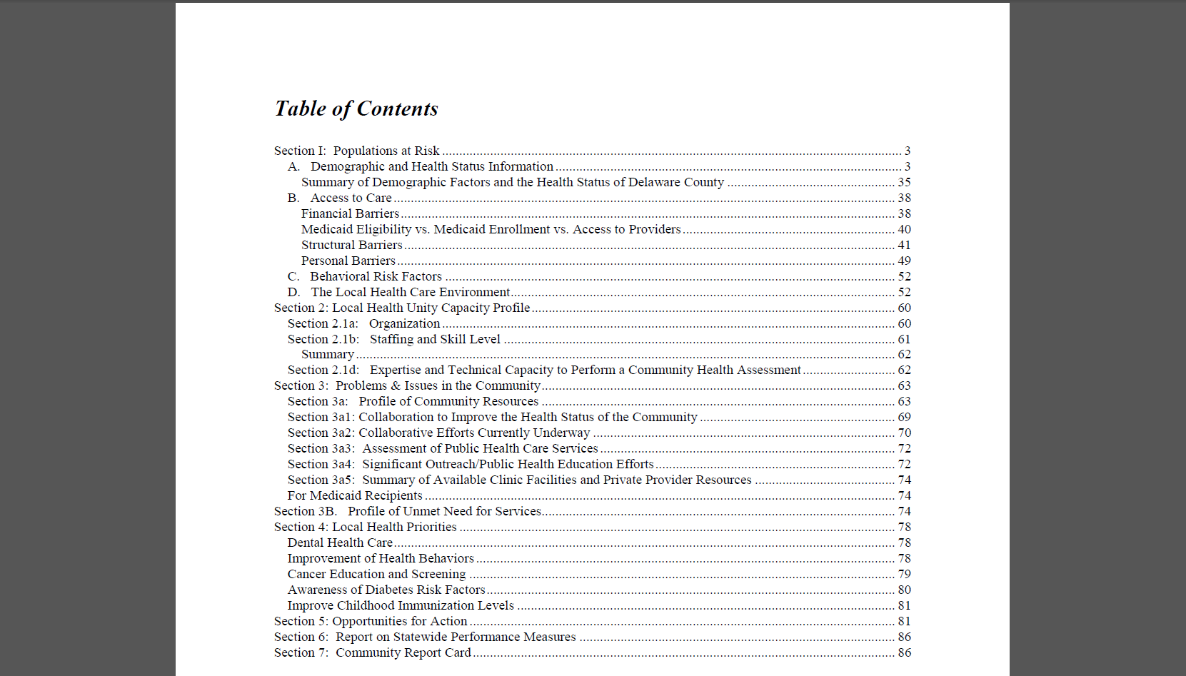

Slide 15
Review
The CHA process both identifies priority health issues in the community and coalesces support and commitment to address priorities.
Community involvement is key to developing a viable CHA.

